Slide 1
Module-2: Supervised Learning:
Regression: Linear regression, Polynomial regression, Model evaluation metrics: MAE, MSE, RMSE.
Classification: Logistic regression, K-Nearest Neighbors (KNN), Decision Trees and Random Forests, Model evaluation metrics: Accuracy, precision, recall, F1-score, ROC-AUC.
Model Training and Evaluation: Train-test split and cross-validation, Hyper parameter tuning using GridSearchCV, Overfitting and underfitting.

Slide 2
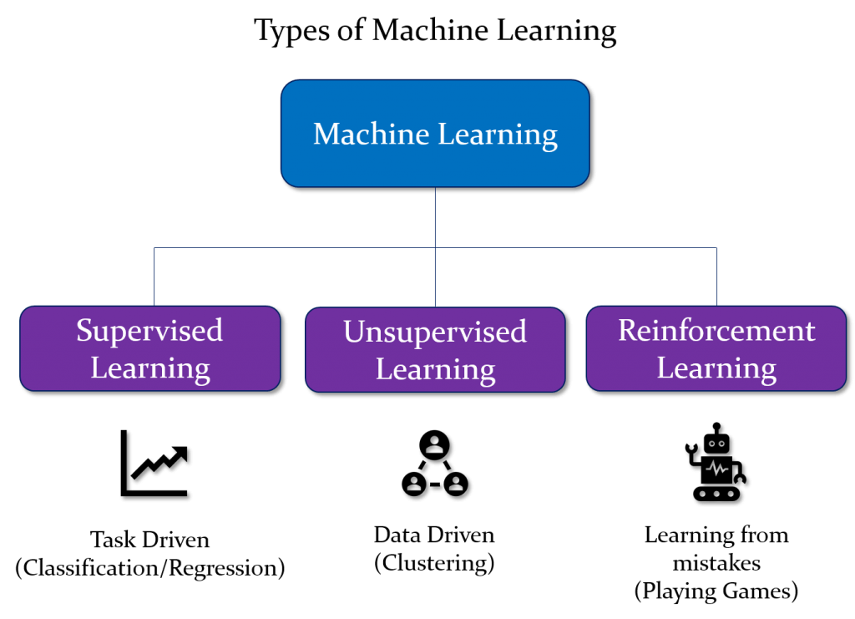

Slide 3
Supervised learning:
Supervised learning is the types of machine learning in which machines are trained using well "labelled" training data, and on basis of that data, machines predict the output. The labelled data means some input data is already tagged or labelled with the correct output.
In supervised learning, the training data provided to the machines work as the supervisor that teaches the machines to predict the output correctly. It applies the same concept as a student learns in the supervision of the teacher. Supervised learning is a process of providing input data as well as correct output data to the machine learning model. The aim of a supervised learning algorithm is to find a mapping function to map the input variable(x) with the output variable(y).
So, the goal of supervised learning is to learn a mapping from inputs to outputs, so that the model can make accurate predictions on new, unseen data.
Note: In supervised learning, models are trained using labelled dataset, where the model learns about each type of data. Once the training process is completed, the model is tested on the basis of test data (a subset of the training set), and then it predicts the output.
https://www.youtube.com/watch?v=olFxW7kdtP8

Slide 4
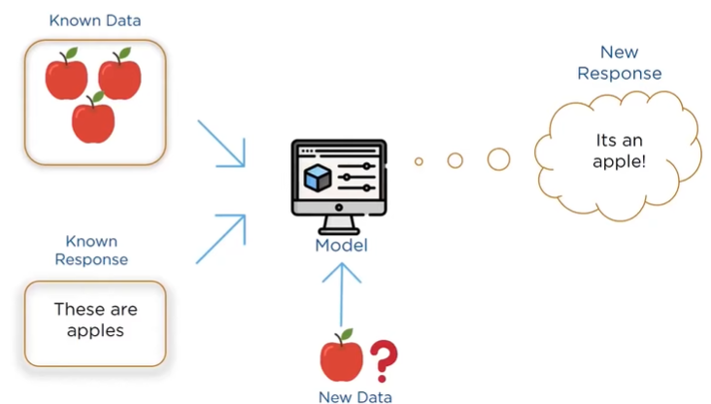

Slide 5
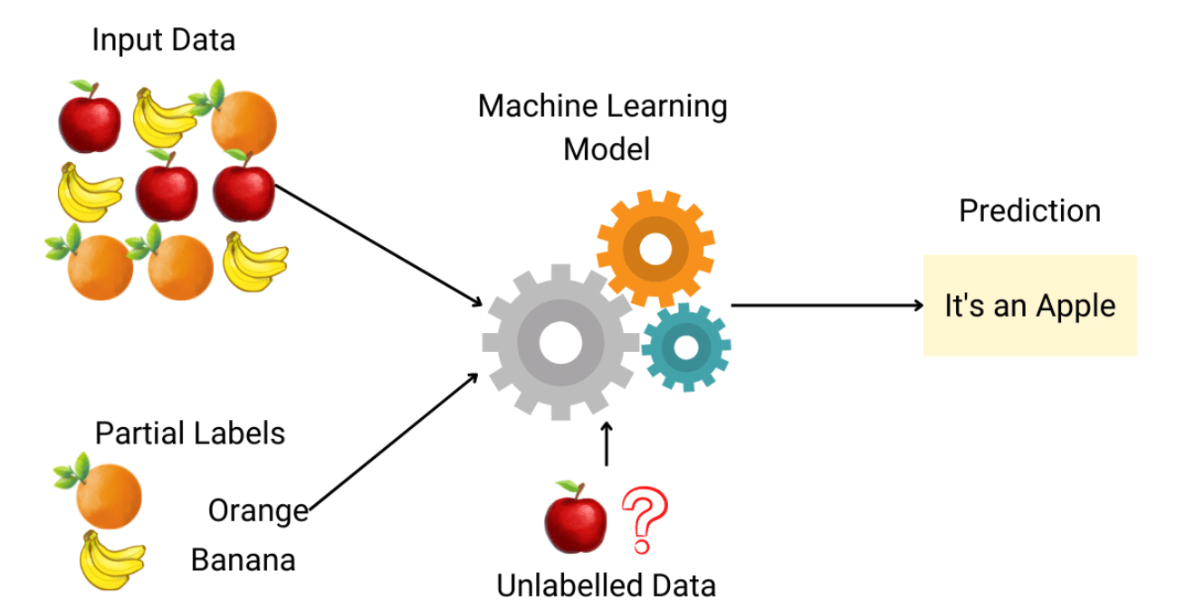

Slide 6
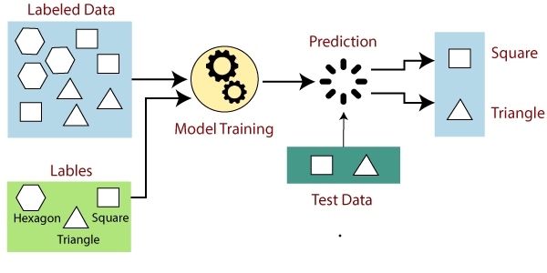

Slide 7
Explanation:
Suppose we have a dataset of different types of shapes which includes square, rectangle, triangle, and Polygon. Now the first step is that we need to train the model for each shape.
If the given shape has four sides, and all the sides are equal, then it will be labelled as a Square.
If the given shape has three sides, then it will be labelled as a triangle.
If the given shape has six equal sides then it will be labelled as hexagon.
Now, after training, we test our model using the test set, and the task of the model is to identify the shape. The machine is already trained on all types of shapes, and when it finds a new shape, it classifies the shape on the bases of a number of sides, and predicts the output

Slide 8
Example-3: Predicting Housing Prices
Let's consider a common example of supervised learning: predicting housing prices based on various features.
Input Features:
Size of the house (in square feet)
Number of bedrooms
Number of bathrooms
Distance to the city center
Presence of nearby amenities (e.g., schools, parks)
Labels (Outputs):
Sale price of the house
Training Dataset:
A dataset containing historical examples of houses with features and their corresponding sale prices.
Model:
A supervised learning algorithm, such as linear regression, is chosen to learn the relationship between the input features and the sale prices.

Slide 9
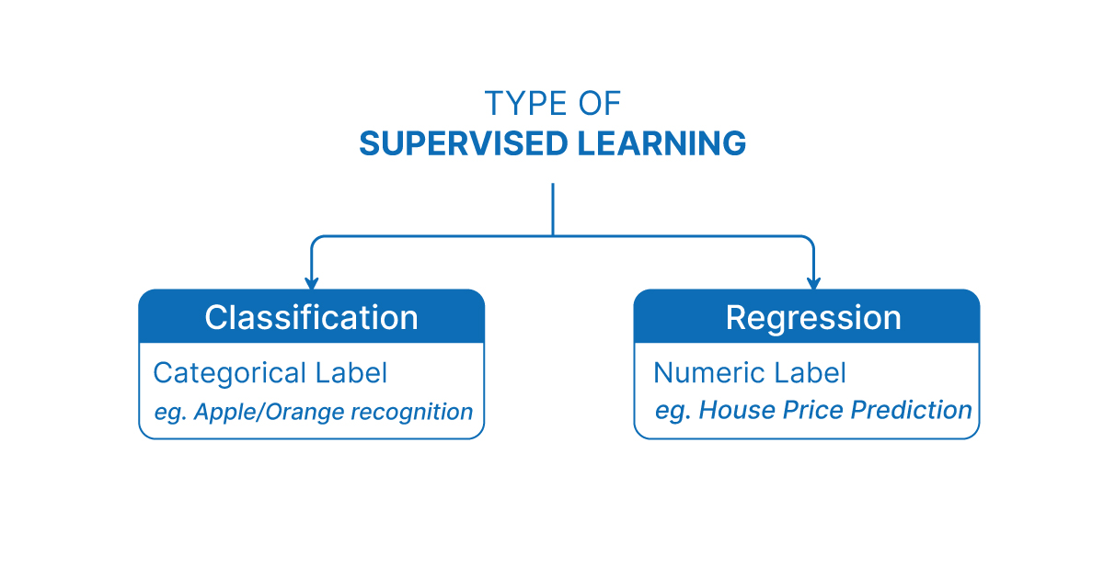

Slide 10
Regression :
Regression is a type of supervised machine learning task where the goal is to predict a continuous numerical value or outcome based on input features.
Regression is a type of supervised machine learning where algorithms learn from the data to predict continuous values such as sales, salary, weight, or temperature.
What mean by continuous numerical value :
In machine learning, the term continuous values refers to numeric values that can take any value within a range, not just fixed or distinct values.
These are real numbers (decimals or integers) that can vary smoothly over a range, as opposed to categorical values, which are fixed labels or classes (like "Yes"/"No", or "Red"/"Green").

Slide 11
Note: In the context of regression in machine learning, a continuous numerical value refers to an outcome or target variable that can take on an infinite number of values within a specific range. In case of predicting a person's age, age is considered a continuous numerical value because it can theoretically take on any value within a certain range (for example, from 0 to 100+ years). There are no gaps or intervals between possible ages, and age can be expressed as a decimal or fraction if necessary (e.g., 25.5 years).
It is a variable that can have any real number value, and there are no distinct categories or classes. The term "continuous" implies that the variable can vary over a continuous range, and there are no gaps or interruptions in the possible values it can take. In contrast, in a classification task, the target variable would be a discrete set of categories or classes.
Note:
Here, “discrete set of categories or classes" refers to a set of distinct and separate values that a variable can take

Slide 12
🔁 Regression Contrast with Classification:
In classification, the outputs are discrete categories, like:
"Pass" or "Fail"
"Spam" or "Not Spam"
"Dog", "Cat", or "Bird"
Whereas in regression, the goal is to predict a number, like:
88.4 marks
₹56,789.25 income

Slide 13
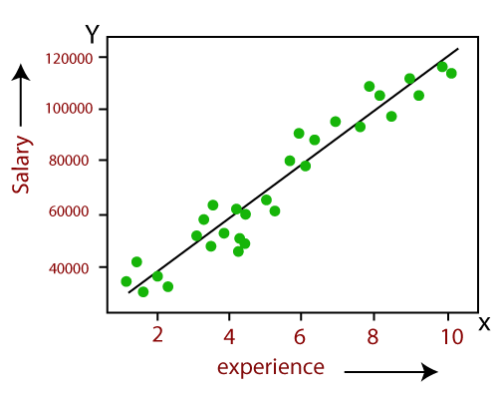
Example:
Linear Regression:
Predicting the salary of an employee on the basis of the year of experience.

Slide 14
Types of Regression:
There are several types of regression techniques, each suited for different kinds of data and relationships between variables.
Linear Regression (Formula: Y = mX + c)
Multiple Linear Regression (Formula: Y = b0 + b1X1 + b2X2 + ... + bnXn)
Polynomial Regression (Formula: Y = b0 + b1X + b2X² + ... + bnXⁿ)
Logistic Regression (Technically Classification)

Slide 15

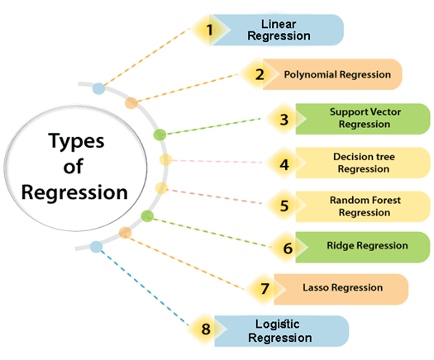

Slide 16
Linear regression:
As the name indicates, simple linear regression is the simplest regression model which involves only one independent variable or predictor and only one Dependent Variable or the Response Variable.
Linear Regression is a supervised learning algorithm used to predict a continuous target variable (Y) based on the value of an independent variable (X), assuming a linear relationship between them.
This model assumes a linear relationship between the dependent variable and the predictor variable i.e, The relationship between Dependent and Independent Variable is Linear. Here Linear means if the value of independent variable increases or decreases then the value of Dependent variable will increase or decreases for sure.

Slide 17
Formula:
Note:
When we are trying to predict a categorical or nominal variable, the problem is known as a classification problem. A classification problem is one where the output variable is a category such as ‘red’ or ‘blue’ or ‘malignant tumour’ or ‘benign tumour’ etc. Whereas when we are trying to predict a numerical variable such as ‘price’, ‘weight’, etc. the problem falls under the category of regression.
Where:
Y = Predicted/Target variable (e.g., Salary)
X = Independent/Input variable (e.g., Years of Experience)
m = Slope (how much Y changes with change in X)
c = Intercept (value of Y when X = 0)
Y = mX + c

Slide 18
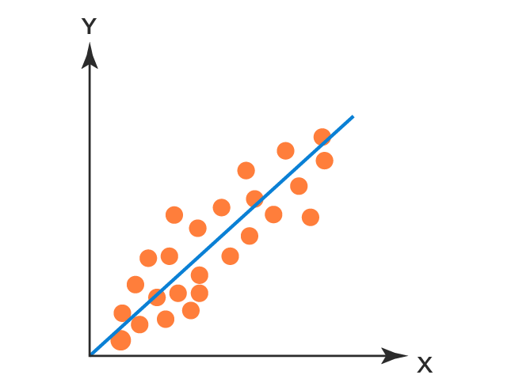
Working of Simple Linear Regression:
The Working of Simple Linear Regression is very Simple that it will draw a straight line in a 2D Plane which is called Best Fit Line.
So our aim is to find the Best Fit Line with minimal Error.
Let’s Take an Example of Height and Weight such that the Problem is to Find a Height of a Person given the Weight.
Note: Best Fit Line is draws based on the Slope of the Line
Best Fit Line
Height
Weight
https://www.youtube.com/watch?v=jerPVDaHbEA

Slide 19
🔢 Example Problem: Predicting Salary
🎯 Goal: Predict the salary of a person based on their years of experience.
🧾 Dataset (Sample):
Here, we want to predict salary for someone with, say, 6 years of experience.
Years of Experience (X) | Salary (Y) in ₹
1 | 3,00,000
2 | 3,50,000
3 | 4,00,000
4 | 4,50,000
5 | 5,00,000

Slide 20
📉 Step-by-Step Process:
Step 1: Visualize Data (Described)
If you plot this data on a graph:
X-axis = Years of Experience
Y-axis = Salary
You will notice a straight-line pattern, which indicates a linear relationship.

Slide 21
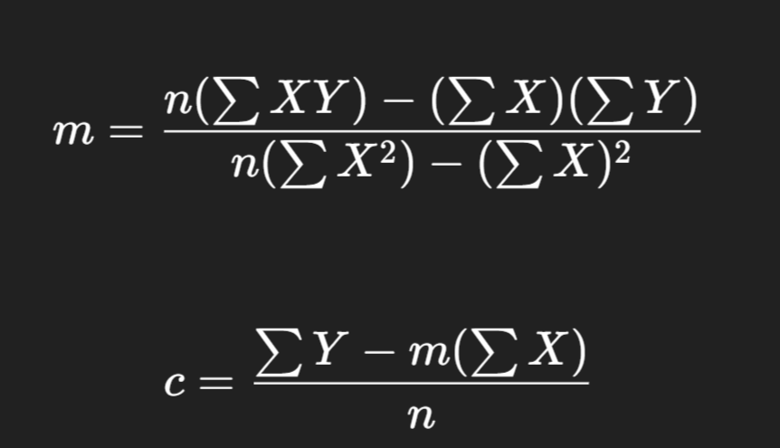
Step 2: Calculate Line of Best Fit
We find values of m (slope) and c (intercept) using a method called least squares, which minimizes the sum of squared differences between actual and predicted salaries.
📌 Slope (m) Formula:
📌 Intercept (c) Formula:

Slide 22
✅ Add Helper Columns — XY and X²
X | Y | X × Y | X²
1 | 300000 | 300000 | 1
2 | 350000 | 700000 | 4
3 | 400000 | 1200000 | 9
4 | 450000 | 1800000 | 16
5 | 500000 | 2500000 | 25

Slide 23
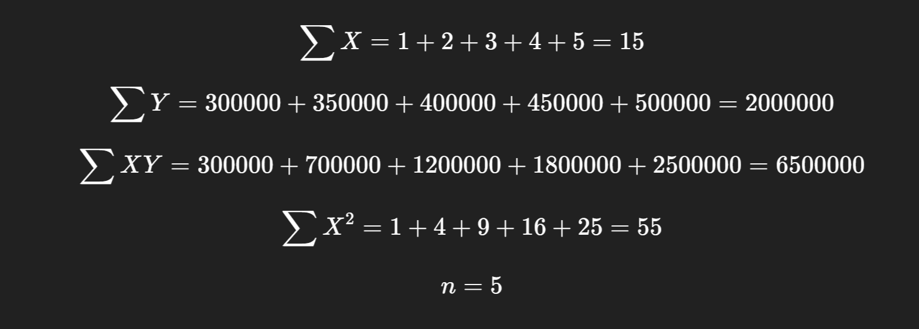
✅ Calculate Summations

Slide 24
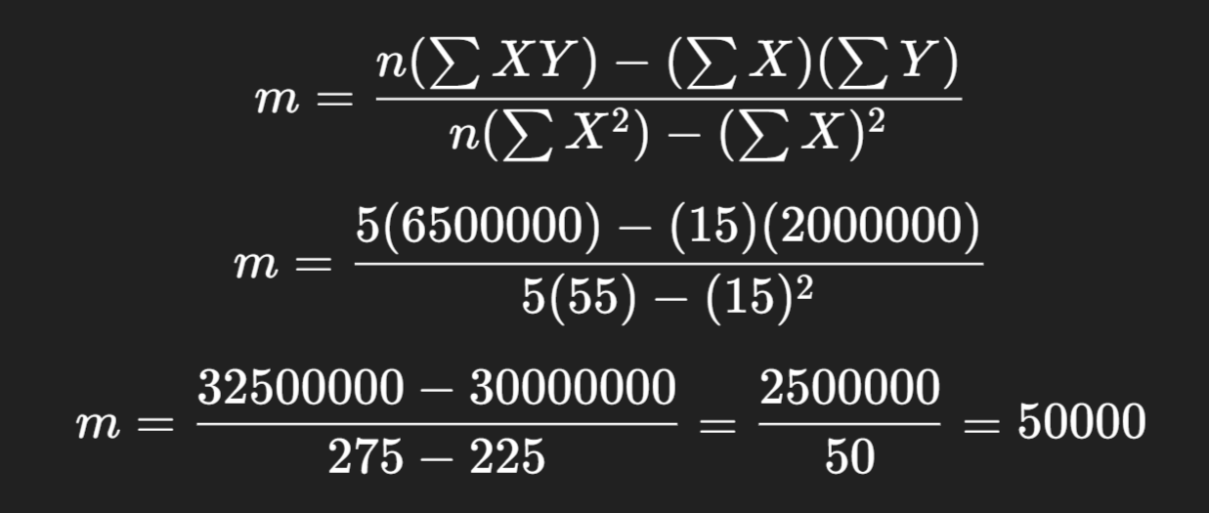
✅ Apply the Slope (m) Formula:

Slide 25
✅ Slope (m) = 50,000
The slope represents how much the salary increases for each additional year of experience.
📘 In Simple Terms:
Every time a person gains 1 more year of experience, their salary increases by ₹50,000 — according to the pattern observed in the dataset.

Slide 26
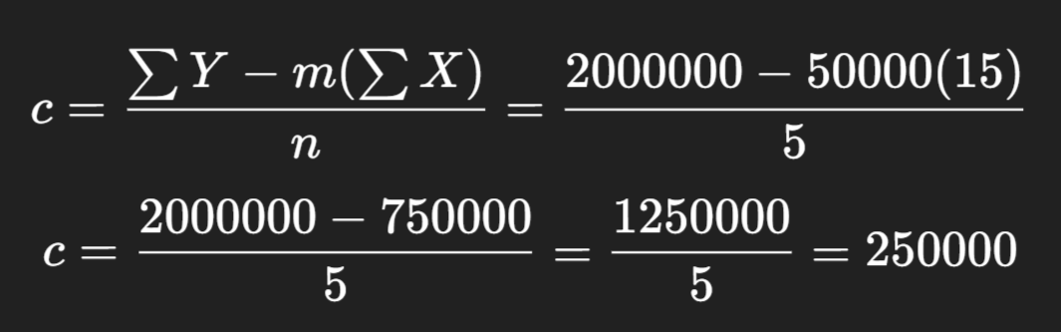
✅ Apply the Intercept (c) Formula

Slide 27
✅ Intercept (c) = ₹2,50,000:
The intercept is the value of Y (salary) when X (years of experience) = 0.
📘 In Simple Words:
Even if a person has 0 years of experience, the model predicts their starting salary will be ₹2,50,000.

Slide 28

✅ Final Linear Regression Equation:

Slide 29
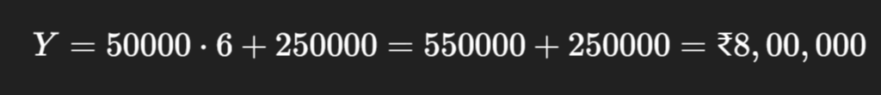
📌 Final Prediction Example:
If a person has 6 years of experience, predicted salary:

Slide 30
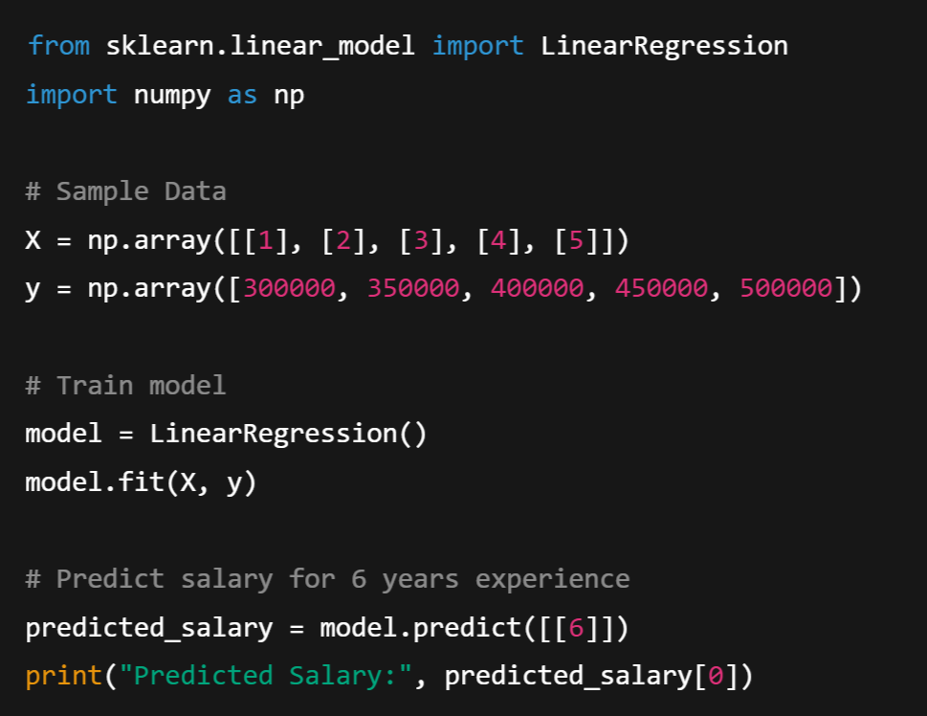
🧪 Python Example
(Using scikit-learn)

Slide 31

Output:

Slide 32
📌 Advantages of Linear Regression
Easy to implement and interpret
Fast to train
Works well with linearly correlated data
Predictive Power
⚠️ Limitations
Assumes linearity or Linear Relationship
Sensitive to outliers
Limited to Numeric, Continuous Data
Doesn’t perform well with non-linear or highly complex relationships

Slide 33
Polynomial Regression:
Polynomial regression model is the extension of the simple linear model.
Polynomial Regression is a type of supervised machine learning algorithm used to predict a continuous dependent variable (Y) based on the value of one or more independent variables (X) — but with a twist:
Unlike Linear Regression, which fits a straight line, Polynomial Regression fits a curved line to the data.

Slide 34
Why Polynomial Regression?
A simple linear regression algorithm only works when the relationship between the data is linear. But suppose we have non-linear data, then linear regression will not be able to draw a best-fit line. Simple regression analysis fails in such conditions. Consider the below diagram, which has a non-linear relationship, and you can see the linear regression results on it, which does not perform well, meaning it does not come close to reality. Hence, we introduce polynomial regression to overcome this problem, which helps identify the curvilinear relationship between independent and dependent variables.
For example:
Salary vs Experience: Salary might grow slowly at first, then rise faster.
Growth of plants: Starts slow, then rapid, then slows again.
Product sales: Might peak and then decline.

Slide 35
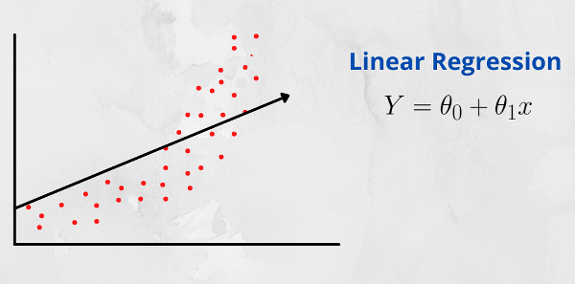
Linear Relationship:
A linear relationship between two variables means that when one variable changes, the other variable changes in a straight-line fashion. In other words, if you were to plot the relationship between the two variables on a graph, the points would form a straight line.
That is, In a linear relationship between two variables, when the value of one variable increases, the value of the other variable also increases if the relationship is positive. Conversely, if the relationship is negative, when the value of one variable increases, the value of the other variable decreases.

Slide 36
Polynomial regression is a form of regression analysis in machine learning (ML) where the relationship between the independent variable X and the dependent variable Y is modeled as an n-degree polynomial. Unlike simple linear regression, which fits a straight line to the data, polynomial regression can capture more complex relationships between variables by introducing polynomial terms.
The general form of a polynomial regression model with one independent variable X can be expressed as:
Polynomial with Degree or Order n:
y = b0 + b1X + b2X² + ....... + bnX^{n} + ε
where:
y is the dependent variable,
x is the independent variable,
b0, b1, b2,…………..bn​ are the coefficients,
n is the l,
ε is the error term.

Slide 37
Polynomial Terms:
Polynomial terms refer to mathematical expressions involving variables raised to powers and multiplied by coefficients. In the context of polynomial regression or polynomial functions, these terms are used to model relationships between variables that are not linear.
A polynomial term typically takes the form bx^{n},
where:
b is a coefficient (a constant multiplier),
x is the variable,
n is a non-negative integer representing the degree of the term (the exponent to which the variable is raised).

Slide 38
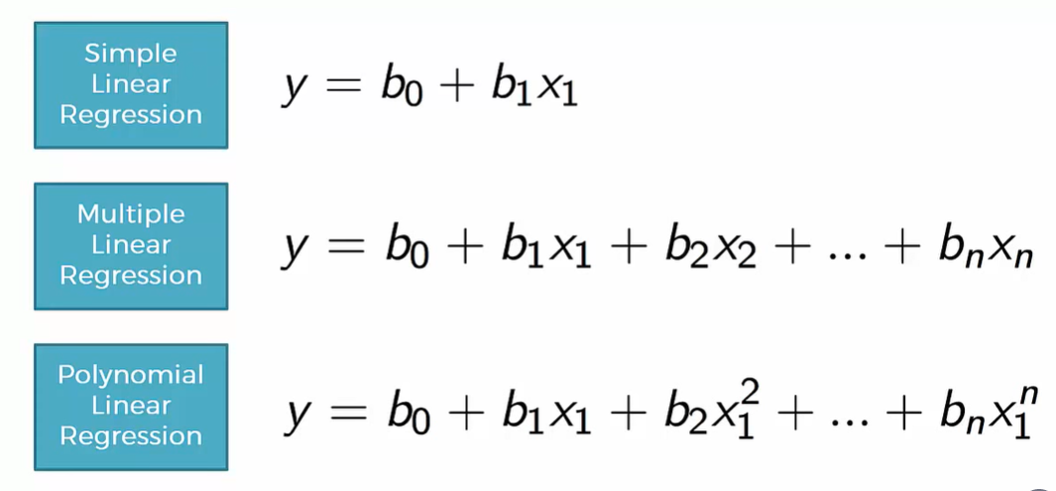

Slide 39
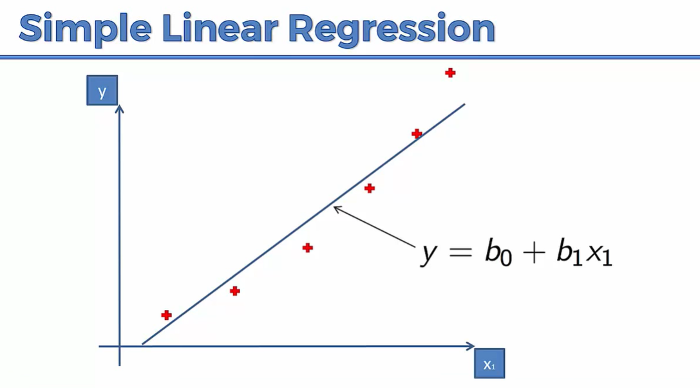

Slide 40
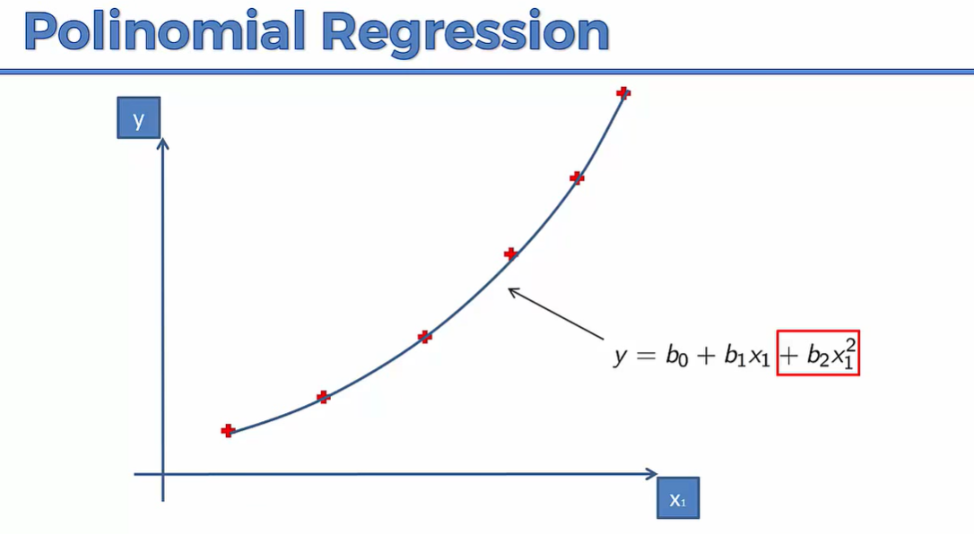

Slide 41
🔢 Example Problem: Predicting Salary
🎯 Goal: Predict the salary of a person based on their years of experience using Polynomial Regression.
🧾 Dataset (Sample):
Here, we want to predict salary for someone with, say, 6 years of experience.
Years of Experience (X) | Salary (Y) in ₹
1 | 3,00,000
2 | 3,50,000
3 | 4,30,000
4 | 5,60,000
5 | 9,00,000

Slide 42
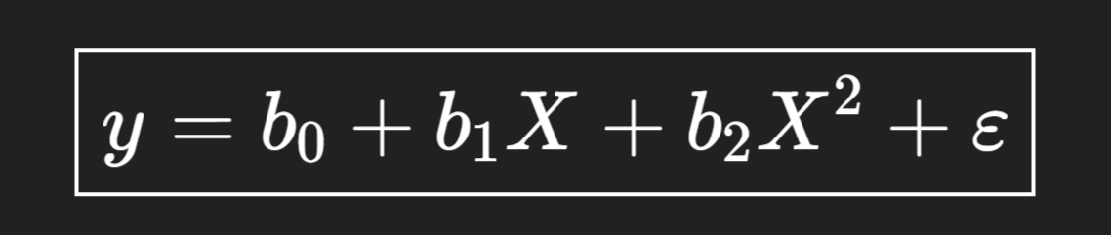
🔍 Observations:
Salary increases slowly at first, then rapidly — this is non-linear growth.
A straight line (linear regression) would not capture this pattern well.
So, we apply polynomial regression with a curve like:
Here, we use a quadratic model (degree 2). You can increase degree (like X³, X⁴...) for more complex curves, but we’ll keep it simple.

Slide 43
✅ Step 1: Compute required columns
X | Y | X² | X³ | X⁴ | XY | X²Y
1 | 300000 | 1 | 1 | 1 | 300000 | 300000
2 | 350000 | 4 | 8 | 16 | 700000 | 1400000
3 | 430000 | 9 | 27 | 81 | 1290000 | 3870000
4 | 560000 | 16 | 64 | 256 | 2240000 | 8960000
5 | 900000 | 25 | 125 | 625 | 4500000 | 22500000

Slide 44
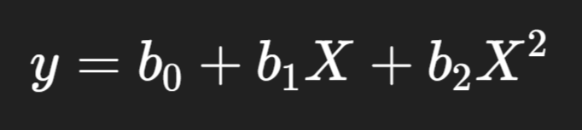
✅ Step 2: Find all totals
∑X=15
∑Y=2540000
∑X2=55
∑X3=225
∑X4=979
∑XY=9030000
∑X2Y=37016000
n=5
We are fitting a quadratic polynomial:

Slide 45
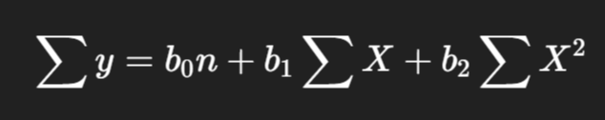
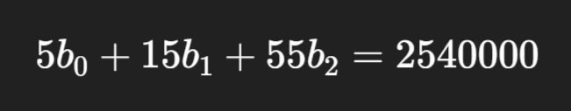
✅ Step 3: Write normal equations:
b0,b1,b2​ are the unknowns (coefficients) we have to find
🧮 Equation 1: Add all the original equations together
We apply summation (∑) on both sides:
This gives the first equation:

Slide 46

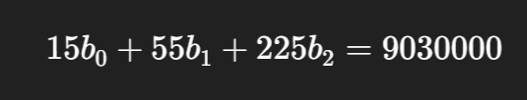
🧮 Equation 2: Multiply each equation by X, then add
We multiply both sides by X and then sum:
This gives:

Slide 47
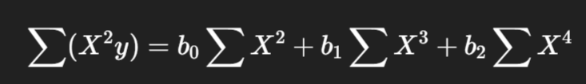

🧮 Equation 3: Multiply each equation by X2, then add
Same idea — multiply both sides by X2, then sum:
Gives:

Slide 48
📌 So why these 3 equations?
Because we’re solving for 3 unknowns:
b0: intercept.
b1: controls slope (linear effect)
b2: controls curve (quadratic effect)
The quadratic effect refers to a specific type of relationship between variables, typically in a mathematical, statistical, or scientific context, where the change in the dependent variable is proportional to the square of the independent variable.
These equations are called the normal equations — and they help the computer find the best-fitting curve behind the scenes.

Slide 49
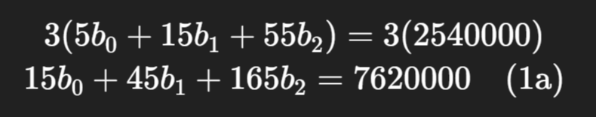
✅ Step 4: Solve the system (simplify the 3 equation):
Eliminate one variable from two equations:
Let’s eliminate b₀ from (1) and (2).
Multiply equation (1) by 3:

Slide 50
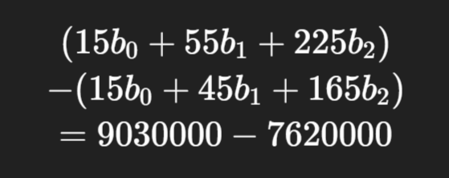

Now subtract (1a) from (2):
Gives:

Slide 51
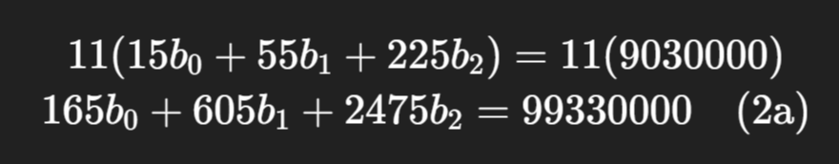
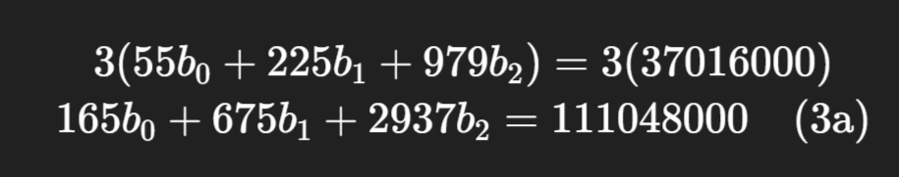
2. Eliminate b₀ from (2) and (3):
Multiply equation (2) by 11:
Multiply equation (3) by 3:

Slide 52
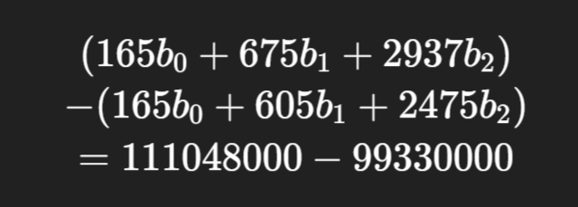

Now subtract (2a) from (3a):
Gives:

Slide 53



3. Solve equations (4) and (5):
Equation (4):
Equation (5):
Let’s multiply (4) by 7:

Slide 54

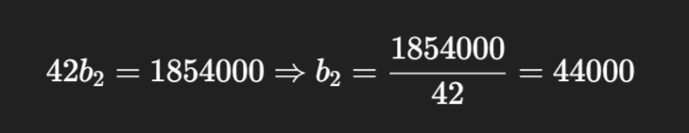
Now subtract (4a) from (5):
Gives:

Slide 55
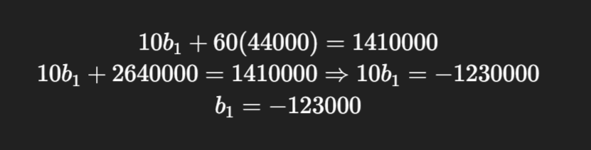
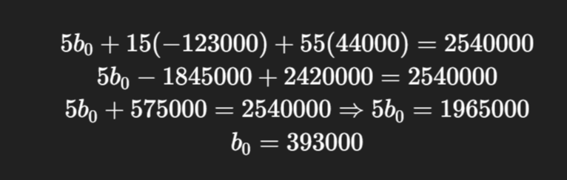
4. Back-substitute to find b₁:
5. Back-substitute to find b₀:

Slide 56
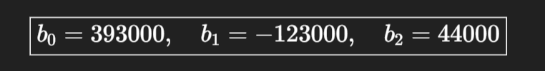

🎉 Final Answer:
✅ Final Equation:

Slide 57
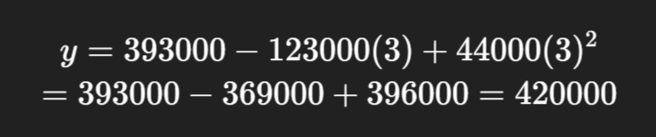
Test the Solution:
For X = 3:
👉 Close to actual value ₹4,30,000

Slide 58
Model evaluation metrics:
MAE (Mean Absolute Error)
MSE (Mean Squared Error)
RMSE (Root Mean Squared Error)
These are commonly used to evaluate regression models, where the goal is to predict continuous values (e.g., predicting house prices, temperatures, etc.).

Slide 59
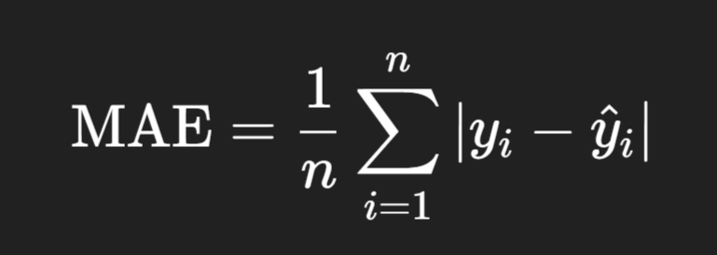
MAE – Mean Absolute Error:
Definition: It is the average of the absolute differences between predicted and actual values.
yi = actual value
𝑦^𝑖 = predicted value
n = total number of predictions
🟢 Interpretable in the same unit as the target variable.
Absolute: Ignoring the sign of a number — whether it's positive or negative — and just taking the magnitude (size).

Slide 60
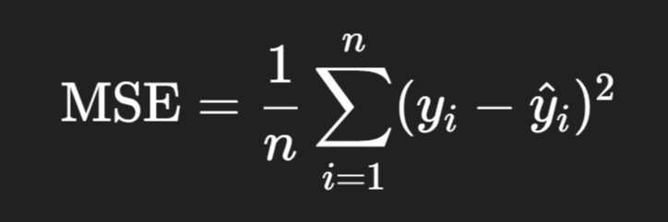
2. MSE – Mean Squared Error:
Definition: It is the average of the squared differences between predicted and actual values.
Penalizes large errors more than MAE due to squaring.
When we say a metric penalizes large errors, it means:
The metric gives more "weight" to big errors compared to small ones.
So, a bigger mistake affects the metric more strongly—especially in MSE and RMSE, because they square the error.

Slide 61
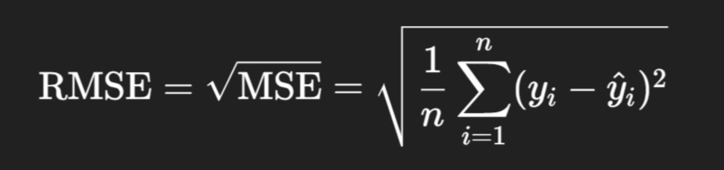
3. RMSE – Root Mean Squared Error:
Definition: It is the square root of the MSE.
Same unit as target variable.
Sensitive to large errors (like MSE), but more interpretable.

Slide 62
Example:
Suppose you have a regression model predicting house prices. You test it on 4 houses.
House | Actual Price (y) | Predicted Price (ŷ)
1 | 100 | 110
2 | 200 | 190
3 | 300 | 310
4 | 400 | 390

Slide 63
➤ Step 1: Calculate Errors
House | Error = y - ŷ | |Absolute Error| | Squared Error
1 | 100 - 110 = -10 | 10 | 100
2 | 200 -190 = 10 | 10 | 100
3 | 300 - 310 = -10 | 10 | 100
4 | 400 - 390 = 10 | 10 | 100

Slide 64
➤ Step 2: Calculate Metrics:
MAE = (10 + 10 + 10 + 10) / 4 = 10
MSE = (100 + 100 + 100 + 100) / 4 = 100
RMSE = √100 = 10
➤ Step 2: Conclusion:
Each predicted price is about ₹10 higher or lower than the actual price — on average.
That 10 tells you how "far off" your predictions are — on average.
Smaller the number → better your model.

Slide 65
🧠 Which one to use?
Use MAE when all errors should contribute equally.
Use MSE or RMSE when large errors should be penalized more.
RMSE is often preferred in practice due to being in the same unit as the original variable.

Slide 66
2. Classification:
Classification is a type of supervised machine learning task where the goal is to predict the category or class that a new instance or observation belongs to, on the basis of training data. The output variable in classification is discrete and represents different classes or labels.
In Classification, a program learns from the given dataset or observations and then classifies new observation into a number of classes or groups. Such as, Yes or No, 0 or 1, Spam or Not Spam, cat or dog, etc. Classes can be called as targets/labels or categories.
Unlike regression, the output variable of Classification is a category, not a value, such as "Green or Blue", "fruit or animal", etc. Since the Classification algorithm is a Supervised learning technique, hence it takes labeled input data, which means it contains input with the corresponding output. The best example of an ML classification algorithm is Email Spam Detector.
The main goal of the Classification algorithm is to identify the category of a given dataset, and these algorithms are mainly used to predict the output for the categorical data.

Slide 67
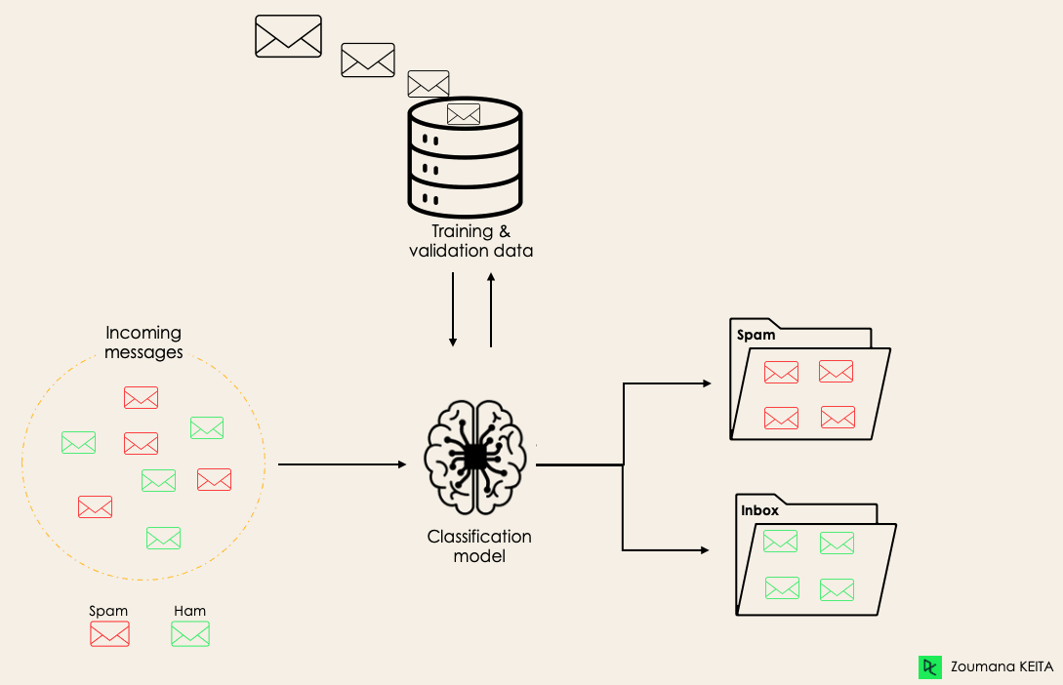
Spam Detection

Slide 68
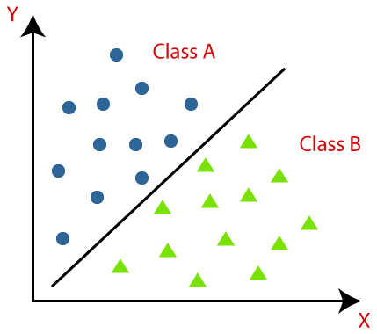
Example-2:
Classification algorithms can be better understood using the below diagram. In the below diagram, there are two classes, class A and Class B. These classes have features that are similar to each other and dissimilar to other classes.
The algorithm which implements the classification on a dataset is known as a classifier.
There are two types of Classifications:
Binary Classification
Multi-class Classifier

Slide 69
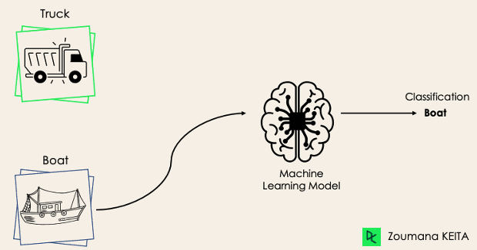
Binary Classification
In a binary classification task, the goal is to classify the input data into two mutually exclusive categories. The training data in such a situation is labeled in a binary format: true and false; positive and negative; O and 1; spam and not spam, male or female etc. depending on the problem being tackled.
For instance, we might want to detect whether a given image is a truck or a boat.
In Binary classification task, “Mutually Exclusive" means that the two categories or classes into which the input data is classified are distinct and cannot occur simultaneously for a single instance of input data.
An email cannot be both "spam" and "not spam" at the same time.
Note: If the classification problem has only two possible outcomes, then it is called as Binary Classifier.

Slide 70
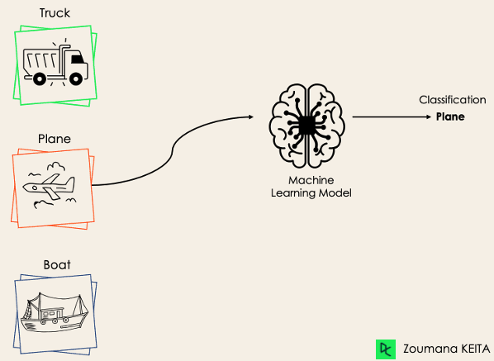
If a classification problem has more than two outcomes, then it is called as Multi-class Classifier.
Example: Classifications of types of crops, Classification of types of music.
Multi-Class Classification:
The multi-class classification, on the other hand, has at least two mutually exclusive class labels, where the goal is to predict to which class a given input example belongs to. In the following case, the model correctly classified the image to be a plane.

Slide 71
Logistic Regression:
Logistic regression is a versatile technique that serves both classification and regression tasks, depending on the context in which it is applied. It's primarily utilized as a classification method and is often referred to as logit regression.
This statistical approach is employed for predicting the outcome of a categorical dependent variable. In logistic regression, the dependent variable (Y) typically takes on binary values (0 or 1), representing two possible outcomes. Meanwhile, the independent variables (X) are continuous in nature, providing predictive features for the model.
Logistic regression is used when our dependent variable is dichotomous or binary. It just means a variable that has only 2 outputs, for example, A person will survive this accident or not, The student will pass this exam or not. The outcome can either be yes or no (2 outputs). This regression technique is similar to linear regression and can be used to predict the Probabilities for classification problems. Like all regression analyses, logistic regression is a predictive analysis.

Slide 72
Logistic regression:
Despite its name, logistic regression is used for classification, not regression.
✅ It predicts the probability that an input belongs to a particular class (like Yes/No, Spam/Not Spam, Pass/Fail, etc.).
🔍 When to use Logistic Regression?
You use it when:
The target variable is categorical (e.g., 0 or 1).
You want to predict probabilities and class labels.

Slide 73
Here's how logistic regression works:
Binary Classification Task: Logistic regression is primarily used for binary classification, where the target variable y has only two possible outcomes (e.g., 0 or 1, "Yes" or "No", "True" or "False").
Sigmoid Function: Logistic regression applies the logistic function also called the sigmoid function to transform the output of a linear equation into a value between 0 and 1.
Logistic Regression is similar to Linear Regression Except Logistic Regression predicts whether something is 0 or 1 i.e, True or False, Instead of predicting something continuous like size, house price, salary etc.
The logistic regression model works by transforming the Linear Regression equation using a Logistric Function, which maps any value between -∞ to +∞ to a range between 0 and 1. The logistic function used in Logistic Regression is called as Sigmoid and it's equation is as follows.
https://www.youtube.com/watch?v=yIYKR4sgzI8&t=13s

Slide 74
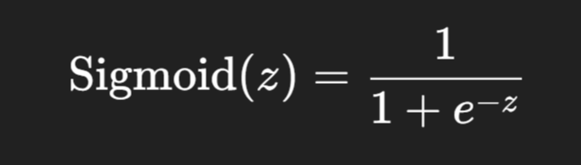
What is the Sigmoid Function?
The sigmoid function is a mathematical function that maps any real number (from −∞ to +∞) to a value between 0 and 1.
It looks like an S-shaped curve (also called a "logistic curve").
Formula:
Where:
z is any real number (could be output of a linear function)
e is Euler’s number (~2.718)
The result is always a value between 0 and 1

Slide 75
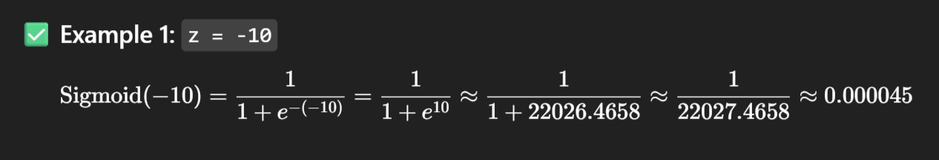
🔍 How it works (some values):
Input (z) | Sigmoid(z) = 1/ 1 + e^-z
-10 | ~0.000045
-2 | ~0.12
0 | 0.5
2 | ~0.88
10 | ~0.99995

Slide 76
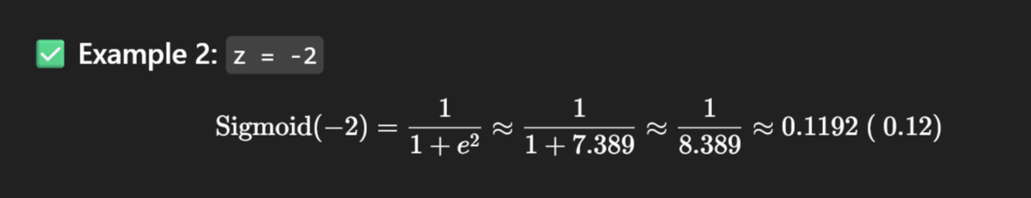
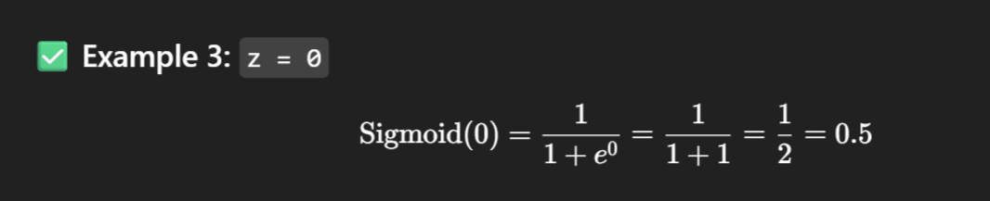
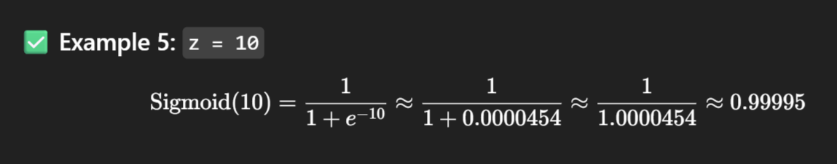

Slide 77
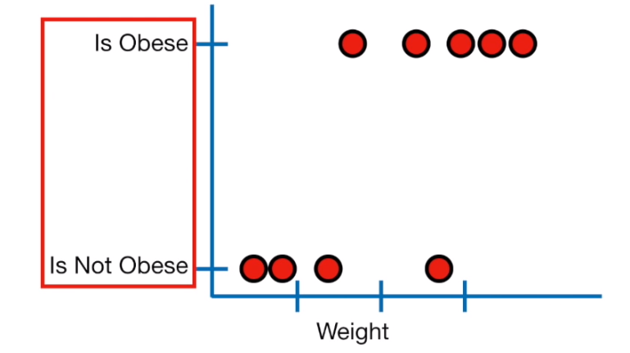
Instead of fitting a line to the data, logistic regression fits an "S" shaped "Logistic Function" or "Sigmoid Function".
Best Fit Line
Height
Weight

Slide 78
🎯 Real-Life Example: Predicting if a Student Will Pass:
Let’s say you want to predict whether a student will pass (1) or fail (0) an exam based on the hours they study.
Hours Studied (X) | Result (Y)
1 | 0 (Fail)
2 | 0 (Fail)
3 | 0 (Fail)
4 | 1 (Pass)
5 | 1 (Pass)
6 | 1 (Pass)
We want a model to predict Y = 0 or 1 based on X.

Slide 79
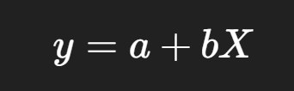
❌ Why not use Linear Regression?
In Linear Regression, we might model it like:
But this can give values like 1.5 or -0.3, which are not valid as class predictions (you can't get "1.5 Pass").
Also, the values are not restricted between 0 and 1, but probabilities must be!
✅ Logistic Regression Fixes This
Logistic Regression applies a sigmoid function to squash outputs to be between 0 and 1.

Slide 80
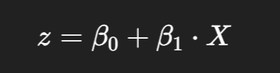
✅ Step 1: Linear Function:
We start by computing a linear combination:
This z can range from −∞ to +∞
Why do we start from a linear equation in logistic regression?
Logistic regression is based on linear regression, but it's used for classification, not regression. So, it keeps the linear combination part and adds a twist to map it into probabilities.

Slide 81
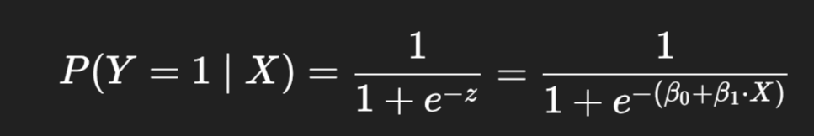
✅ Step 2: Apply Sigmoid Function:
Now, convert z to a probability using the sigmoid:
This gives a probability between 0 and 1.
✅ Step 3: Classification
We now set a threshold, typically 0.5:
If probability ≥ 0.5 → predict 1 (Pass)
If probability < 0.5 → predict 0 (Fail)

Slide 82


✅ Step 4: Suppose the trained model gives: β0 =−5, β1=1.5
✅ Step 5: Make Predictions:
Let’s plug in x = 3 (3 hours studied):
That means: 38% chance of passing
Since 0.38 < 0.5 → Model predicts Fail (0)

Slide 83
✅ Advantages of Logistic Regression
Simple and fast
Works well for linearly separable data
Gives probabilities, not just labels
Easy to interpret
❌ Limitations
Assumes a linear boundary between classes
Not suitable for complex, non-linear patterns (use Decision Trees, SVM, Neural Networks for that)

Slide 84
Module-2: Supervised Learning:
Regression: Linear regression, Polynomial regression, Model evaluation metrics: MAE, MSE, RMSE.
Classification: Logistic regression, K-Nearest Neighbors (KNN), Decision Trees and Random Forests, Model evaluation metrics: Accuracy, precision, recall, F1-score, ROC-AUC.
Model Training and Evaluation: Train-test split and cross-validation, Hyper parameter tuning using GridSearchCV, Overfitting and underfitting.

